Slide 1


Your City Weather at a Click
Coding BootCamp
Photo credit: Summer News 1

Slide 2
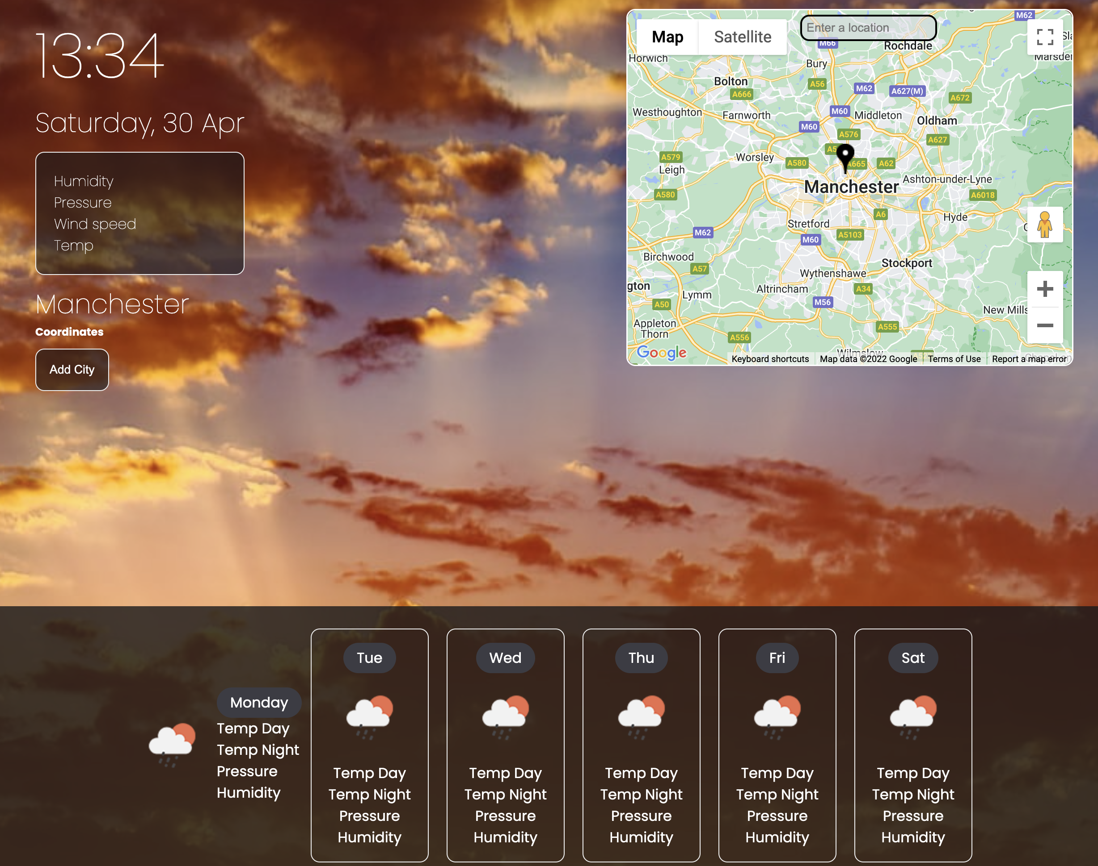
Elevator pitch
Whether you want to know your city weather or the weather of a city 3000 miles away, all you have to do is click on that city name on the map. You get the weather forecast for the current day and the weather forecast for the next 6 days. Want weather for more cities? Just click on the map.

Slide 3
Project Description
This platform allows the user to click a city on the map. In response to clicking, current weather information for the day and the weather forecast for the next 6 days are displayed to the user.
The user can add more cities if they wish to monitor the weather in that city. The user’s selection is stored locally, and upon revisiting the platform, they can view their previous selections.

Slide 4
Motivation for Development
The weather forecast displayed for users on most mobile phones such as iPhones and Android phones only shows the weather forecast at the user’s city or location but does not give weather information for the cities closer or locations further away. A user will have to consult other sources of information to get the weather forecast for other locations.
We wanted to provide the user with technology to access weather information of any city or location by clicking a city name on the map. Such information could enable users to make vacation plans or when to plan outdoor activities elsewhere other than their current location.
Project different from the weather planner homework given in week 6. inspiration from week6, create a weather forecast application with google map click and input, turn it in to a weather planner.

Slide 5

User Story
As a national tourist agency,
I want a web application to show the weather on a map and store weather information for the next 5 days in a different location
So that tourists can make a good plan based on the weather for their chosen vacation destinaton
Credit: Mountain Goat Software

Slide 6
Process
Technologies used
HTML
CSS
JAVASCRIPT
Breakdown of tasks and roles
Matteo - HTML and CSS
Shing – Google Map API integration, JavaScript, Platform integration
Gabriel – Open Weather API integration & JavaScript

Slide 7
Challenges
Google Map API Integration & JavaScript
-Setting up the google map in the HTML
-Generate the Lat Lng coordinate from the google map API
-Generate only one marker each time from every click and input
-Setting up the google map in the HTML
-an "add city" button, that add city name and forecast information to the separate container.
HTML & CSS
- Create a landing page to show off the product. It needs to be attractive and informative and easy to understand
-Float property: floated elements don’t stay in the normal flow. The default flow for HTML elements is linear.

Slide 8
CHALLENGES
Weather Map API & JavaScript
-Struggle with date conversion from JavaScript to normal date
-Challenges mapping API data to HTML document
-

Slide 9
Successes
Google Map API Integration & JavaScript
-Used "clickPos = mapsMouseEvent.latLng.toJSON()" to find out the coordinate from each click and input
-Included an auto-complete input box
-Put markers into an array and created a function, so that it clear the previous marker every time clicked and input on the map
HTML & CSS
-Cards for weather data, everything you need is all in one neat and tidy space.
Weather Map API & JavaScript
-Successfully mapped weather API data to document body, so that the current weather and future weather forecast are both available for every API call.

Slide 10
Directions for Future Development
Add a list of interesting activities a local or international tourist can do in each city
Add a list of tourist attraction sites unique to each city
Create or link with APIs for interesting events planned in the city
Add city to the weather planner
The above information should be available at the click on the map with the option to follow a link and get more information.

Slide 11
Links
Deployed on Github pages
https://shingchan95.github.io/know-your-city/
Github Repo link
https://github.com/shingchan95/know-your-city

